Slide 1
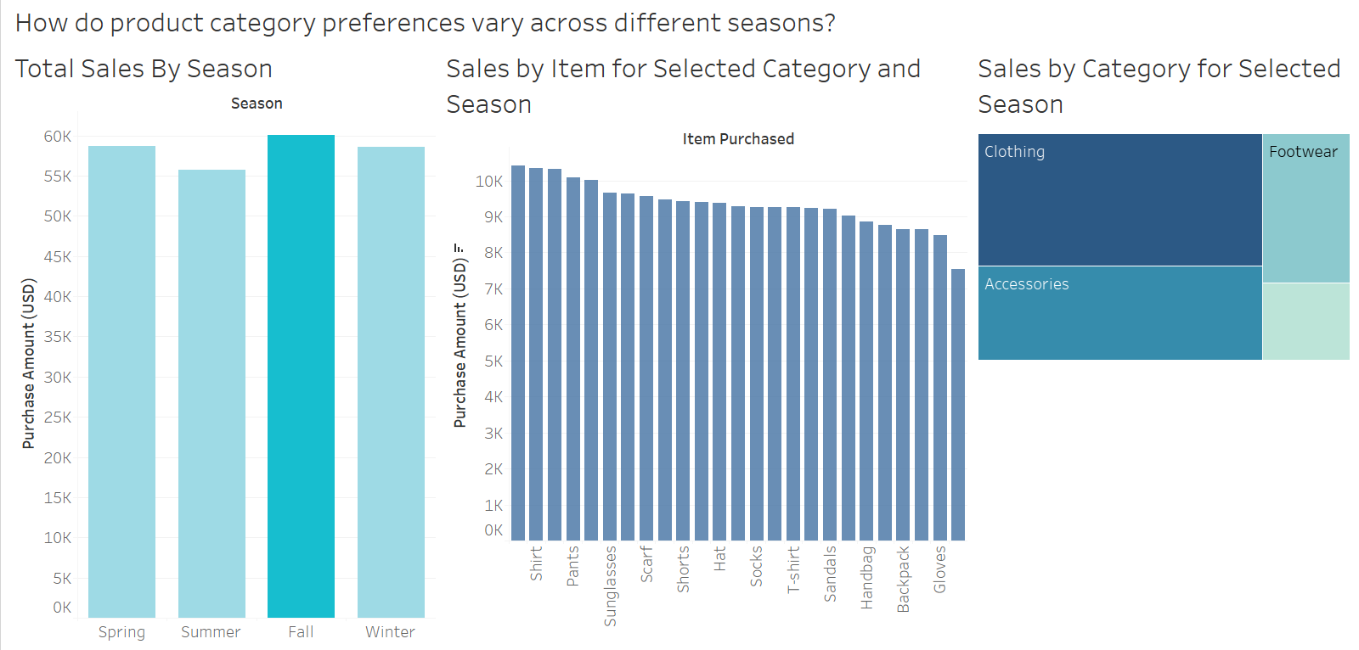
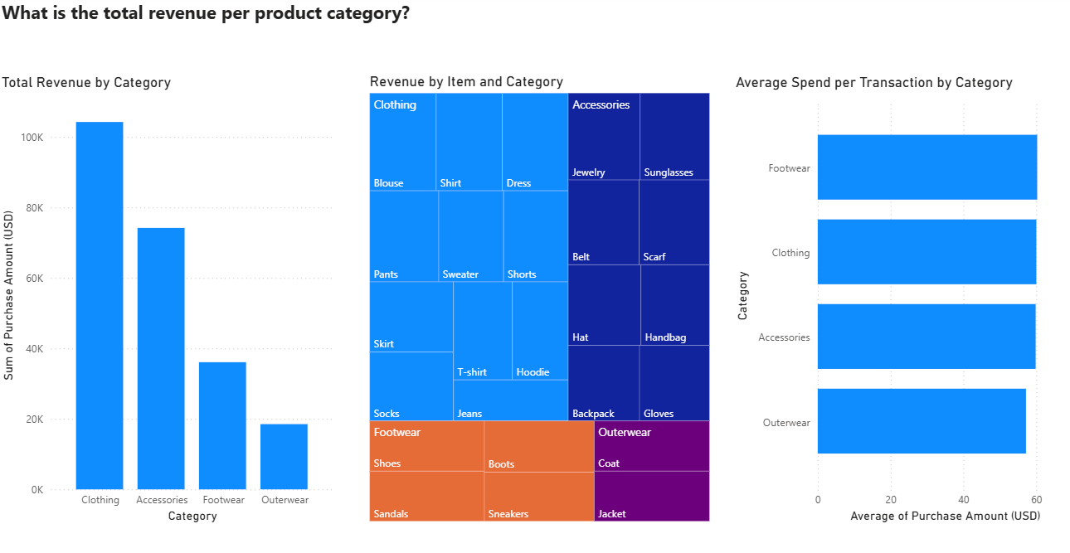

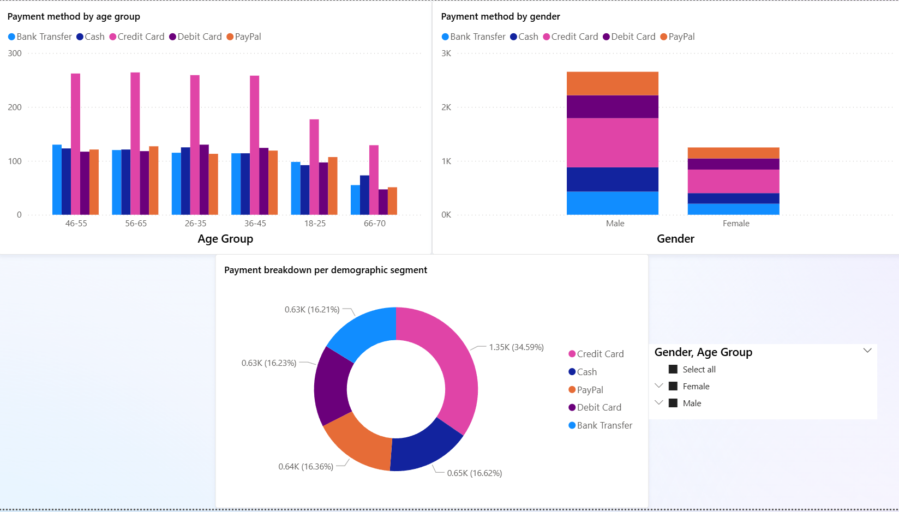
Customer Shopping Trend and Behaviour Analysis
Project Overview
Problem: A struggle retail businesses often face is trying to understand customer purchasing patterns which limits their ability to tailor marketing strategies and optimise sales. This is because without actionable insights into consumer behaviour, companies risk inefficient resource allocation and missed opportunities for customer engagement.
Requirements: A comprehensive analysis of customer shopping data to identify trends, segment customers, and derive actionable insights. The project requires preprocessing raw data, performing exploratory data analysis (EDA), applying clustering techniques for customer segmentation, and developing individual dashboards using Power BI or Tableau to visualize findings.
Solution: The project entails cleaning and improving the customer dataset, segmenting clients according to their spending patterns, demographics, and frequency of purchases using K-means clustering, and performing EDA to identify purchasing trends. Each team member will design a interactive Power BI/Tableau dashboard to display insights, allowing companies to better target their marketing campaigns and increase client retention.
Technologies: Python for data preprocessing and EDA, K-means clustering for segmentation, Power BI/Tableau for interactive dashboard development, and Excel to perform data exploration.
Product category preferences by seasons
Total revenue produced by each product category
Team Members
Muhsinah, Eva,
Han Shen
Supervisor
Mr Wee Kin Guan
Preferred payment method by age group and gender
Notes:
NOTES
Refer to write ups in ‘Past Projects for Reference’ Booklet for Project overview write ups - Student Academic - Project (sharepoint.com)
ENGLISH – British. E.g. organisation VS organization
Font: RP approved font - Arial family only.
Header: Arial Bold
Copy text: Arial regular or Arial Bold. Use Emphasis of SOI’s orange colour in moderation.
Picture frame – Give a 4.5 or 6pt orange outline.

